Slide 1
Smart Home Technology
and
Greek Consumers
Βασίλης Κωστόπουλος
Λάμπης Παπαϊωάννου
Πέτρος Μπινής

Slide 2
Introduction
Smart homes are residences equipped with interconnected devices and systems, that aim to increase the user’s comfort, security and entertainment while also providing him with energy information as well as the ability to remote control the devices.
Some examples include:
Smart lighting
Entertainment devices
Security cameras
Voice assistants

Slide 3
Benefits
Barriers
Time saving
Reduced energy consumption
Improve people’s well being(companionship, support, assistance)
Control and Monitoring Services
High cost in purchasing, installing and maintaining all the different devices
Personal data breach
Lack of legal coverage

Slide 4
Purpose of the Study
Investigate the degree of acceptance of smart home technology services by Greek consumers
Record the benefits and disadvantages of using smart home technology services
Investigate factors that affect the acceptance of smart home technologies in Greece.

Slide 5
Methodology
Three steps made up the research procedure for this study: designing in the research and questionnaire; gathering data; analyzing the data; and drawing conclusions.
Convenience Sampling was selected.
The final sample consisted of 108 insightful surveys.
Participants were asked for their consent so they could anonymously share their opinions about smart home technology and services.

Slide 6
Methodology
Questions on respondents’ demographic characteristics are included in the opening part of the questionnaire.
Second part: questions concerning the factors that influence the adoption of smart home technology.
Third part: allowed participants to share which benefits and obstacles of the smart home technology are paramount to them and which smart home devices they use, would use, and will use in their own household.

Slide 7
Methodology
• The sample consists of 20 answers.
• An online questionnaire was used to collect data from the participants.
• Participants were reassured that their data will remain private.
• The questionnaire begins with demographic questions.

Slide 8
Methodology
• The next part of the questionnaire includes 33 statements about the preferences, abilities, beliefs and intents of participants.
• Participants were given the opportunity to indicate their level of agreement with each statement through 5 different choices.

Slide 9
Methodology
Some of the research questions included in the questionnaire are:
• I prefer using new technology in areas such as home security
• I find the e-payment services useful
• I intend to use smart white devices
• I am able to use the smart devices of my home without learning or technological specialization

Slide 10
Main Results
General Perceptions
Smart technology is generally considered easy to use, compatible and useful, especially for elderly
Recognized cost-saving benefits of smart devices
Low degree of influence from social environment
Trust in electronic information services, not as much in telemedicine or payment methods
High level of perceived enjoyment

Slide 11
Technology and Social Groups
Not significant differences in intention to use smart technology among ages and educational levels
Higher intention to use such technology from males
Connection between high incomes and expression of usefulness
Lower degree of social influence from lower incomes

Slide 12
Findings

Slide 13
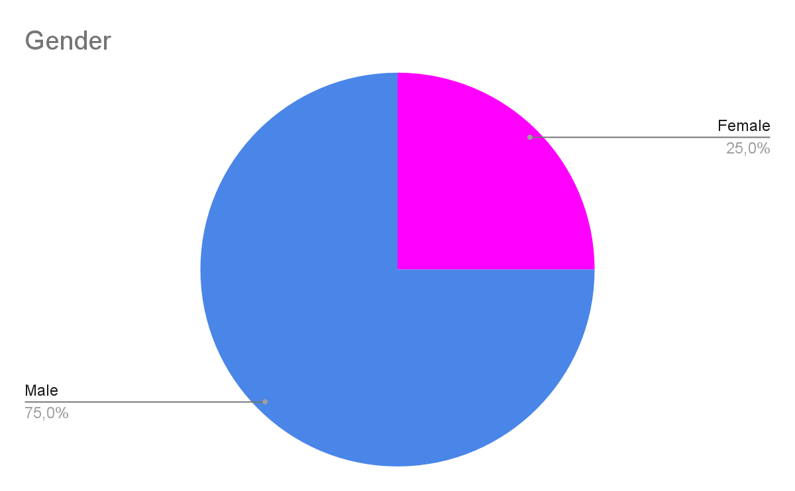
The participants (n = 20) were mostly males (75%) (females, 25%)

Slide 14
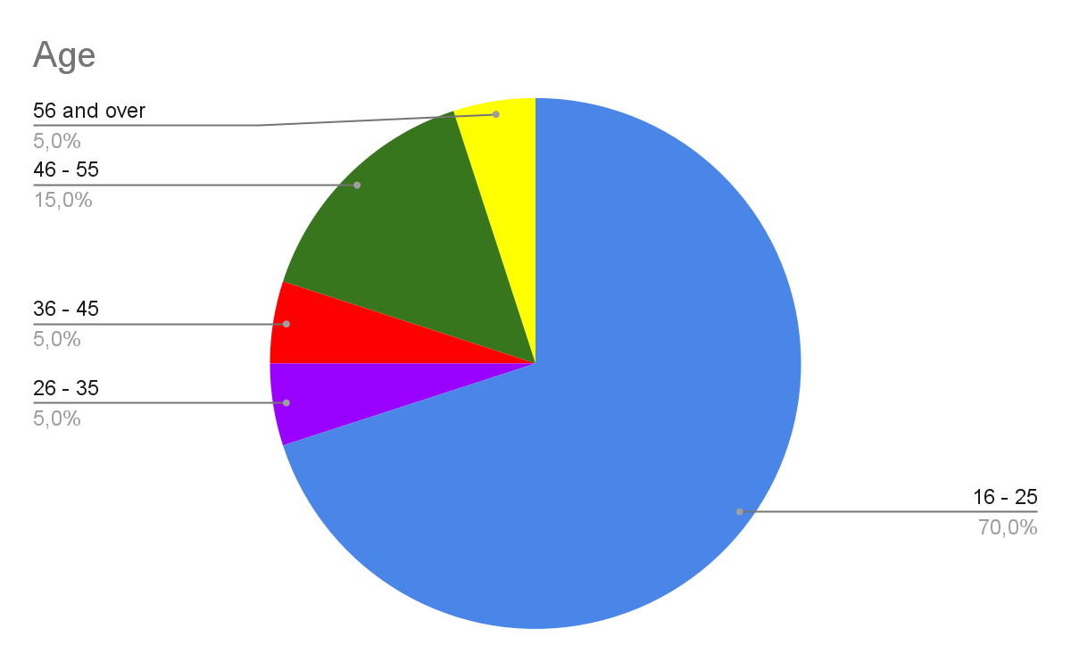
The majority of participants (70%)(n = 14) were between the ages of 16 - 25

Slide 15
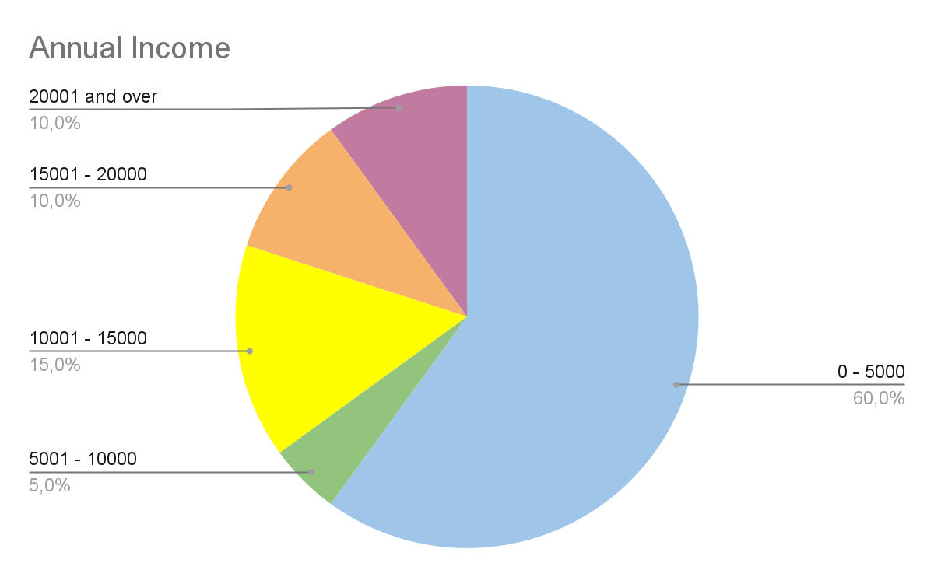
60% (n = 12) of participants earned 0 - 5000 euros annually

Slide 16
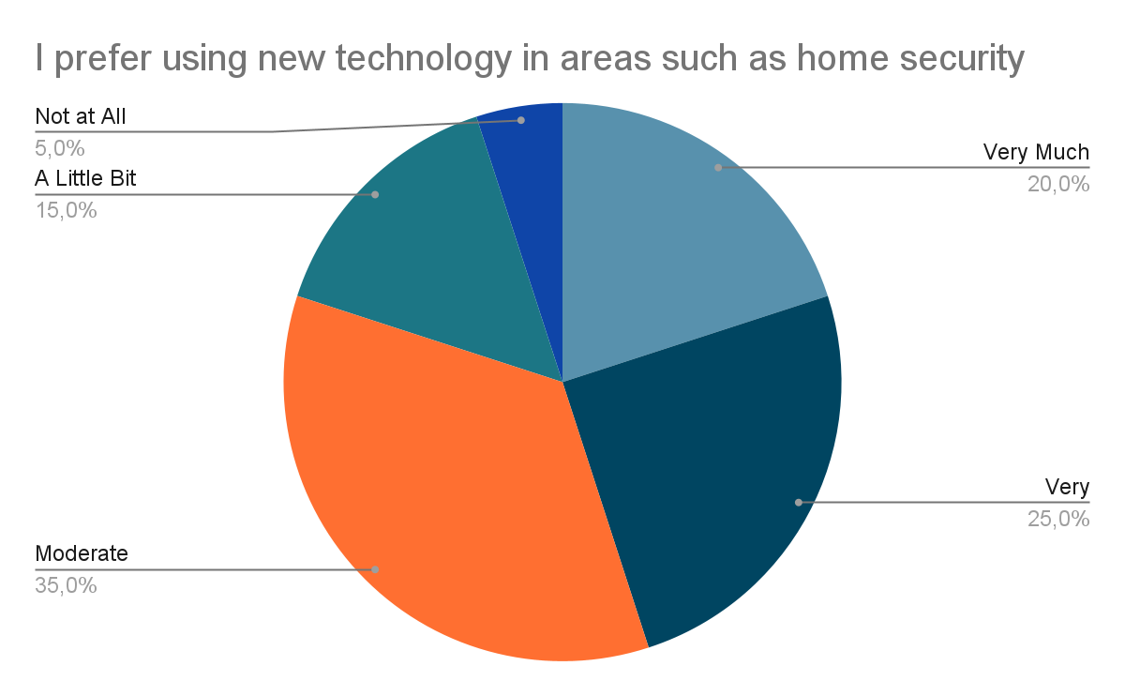
The vast majority of participants showed a preference for the use of new technology in regards to home security

Slide 17
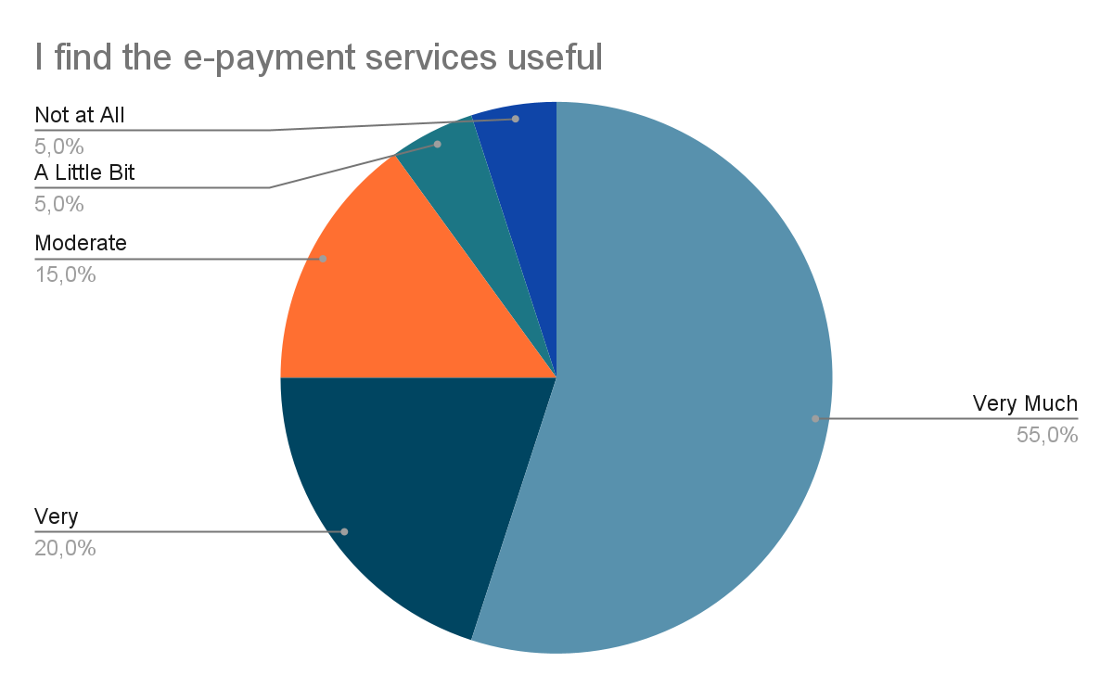
Participants also showed a strong preference for e-payment services

Slide 18
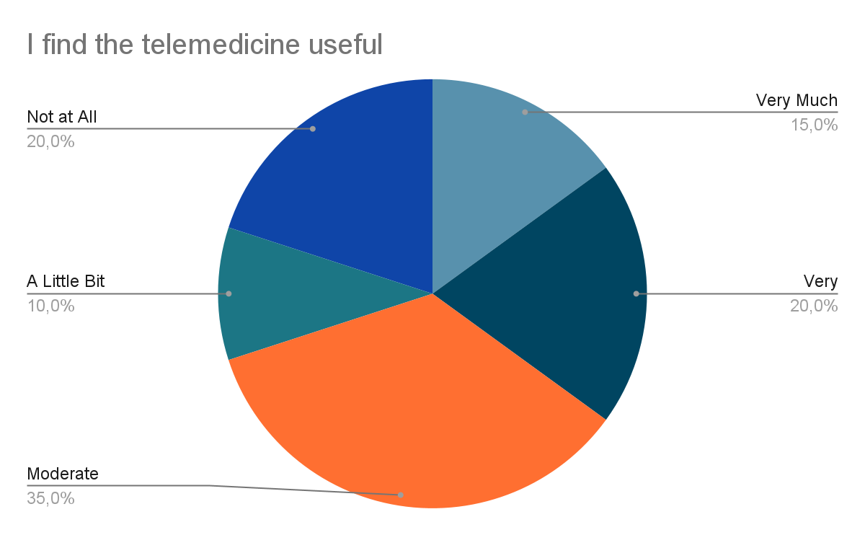
The majority of participants believe that telemedicine is useful

Slide 19
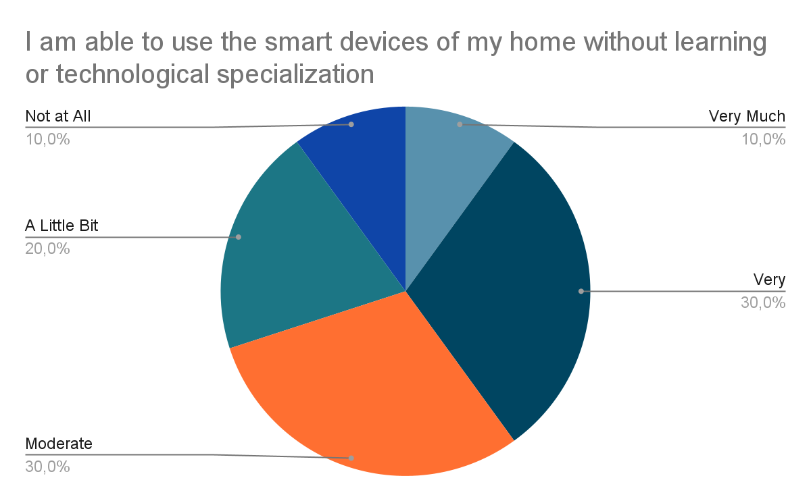
To a large extent, the participants feel able to use the smart devices of their home without having any technological expertise

Slide 20
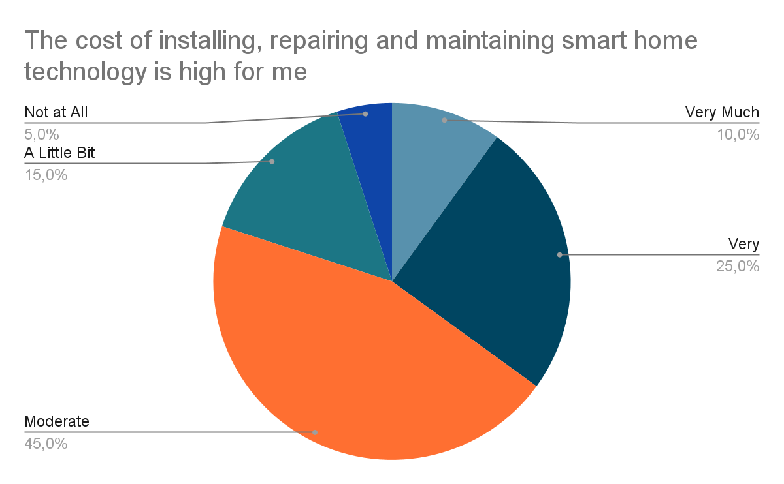
A large portion of participants believe that installation, repair and maintenance of smart home technology is high for them

Slide 21
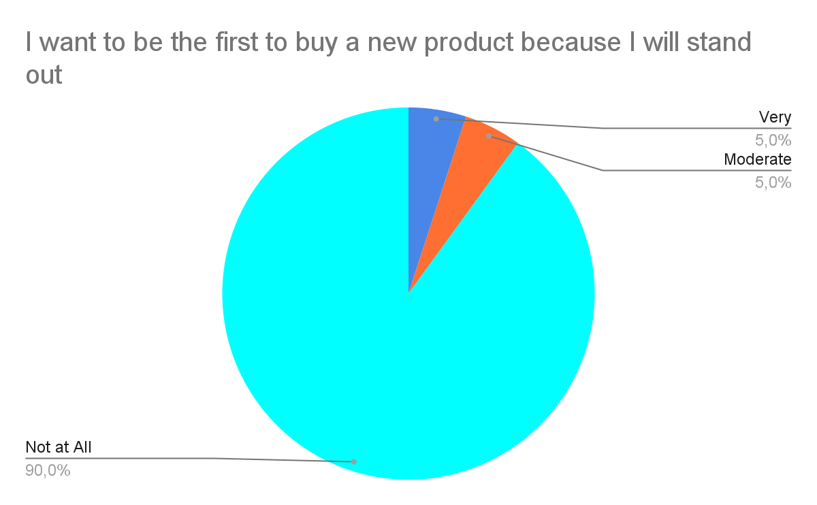
Nearly all participants agreed that social recognition was not a factor when purchasing a new product

Slide 22
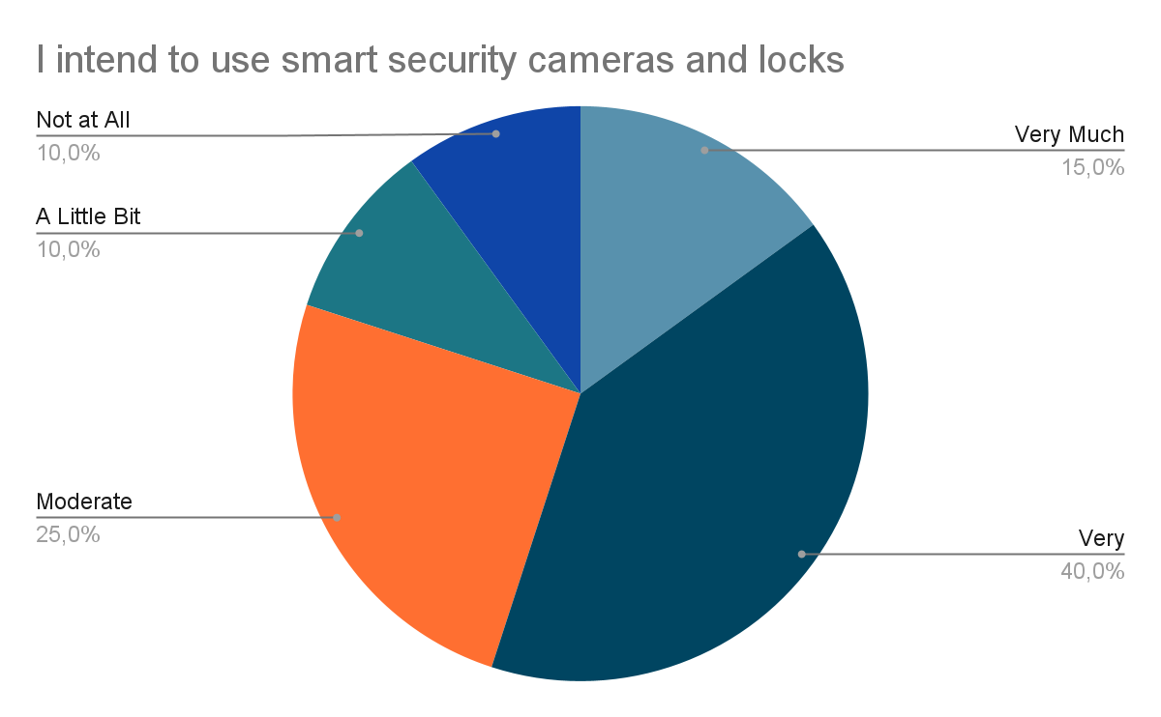
The majority of participants intend to use smart security cameras and locks

Slide 23
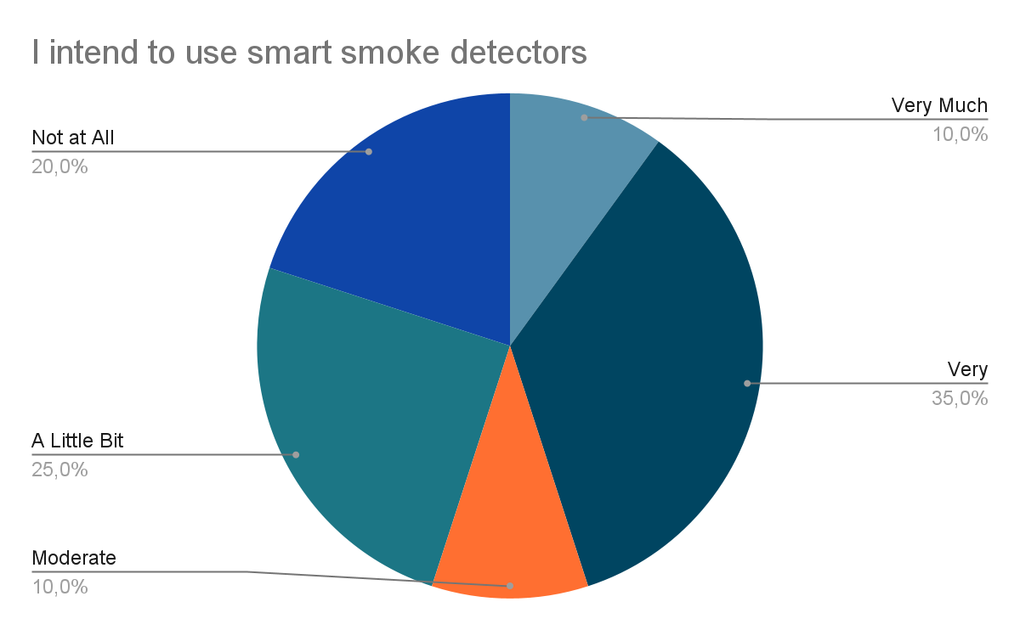
Participants showed moderate intent to use smart smoke detectors

Slide 24
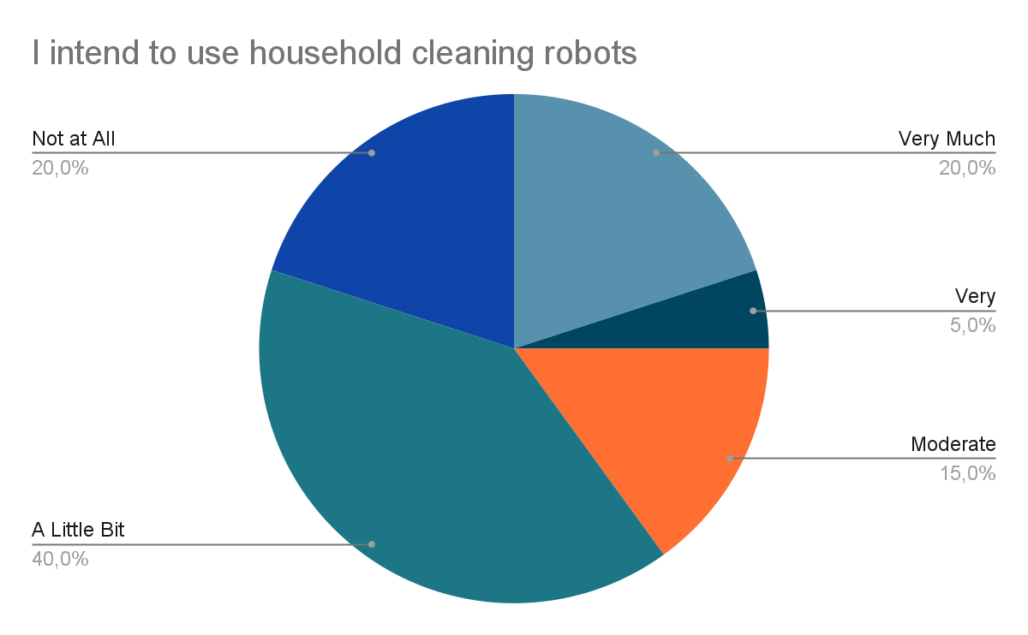
Participants showed low to moderate intent to use household cleaning robots

Slide 25
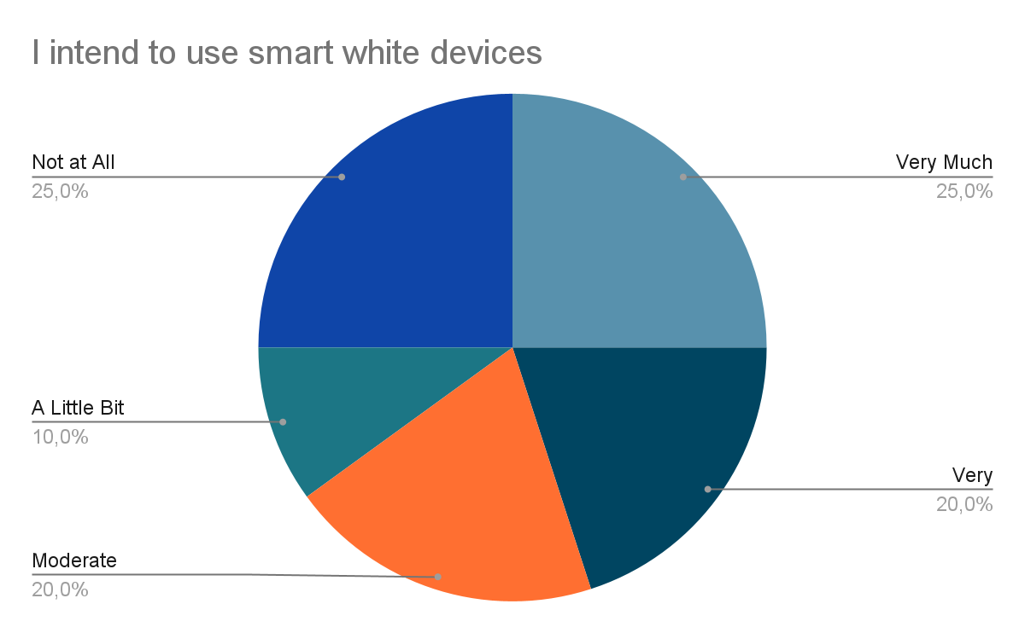
Participants showed moderate to high intent to use smart household appliances (Smart fridges, air conditioners, washing machines etc.)

Slide 26
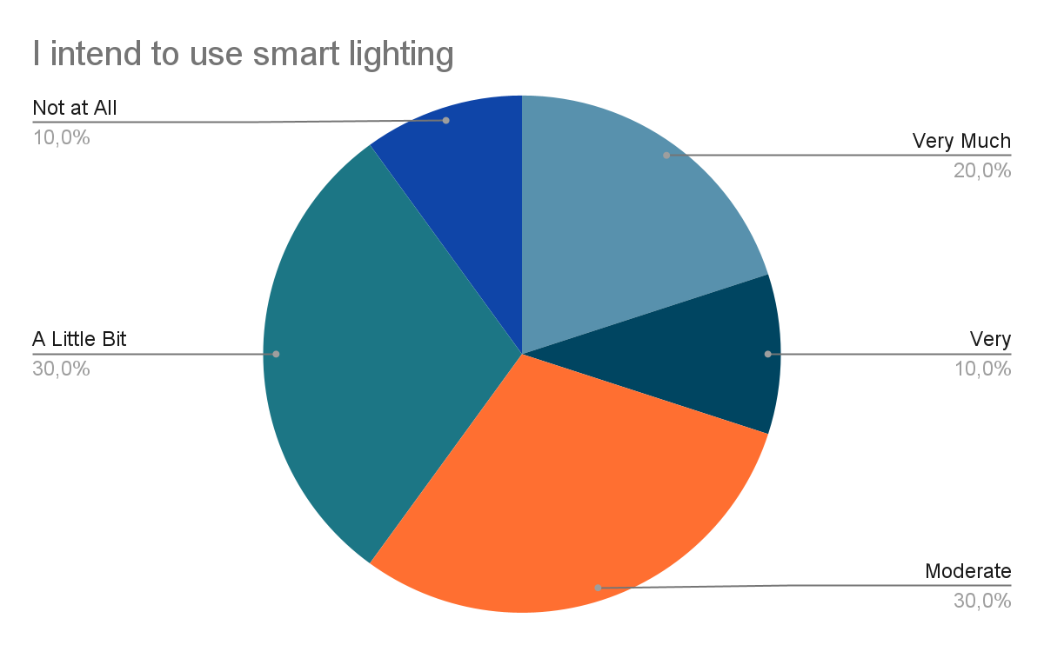
Participants also showed moderate intent to use smart lighting

Slide 27
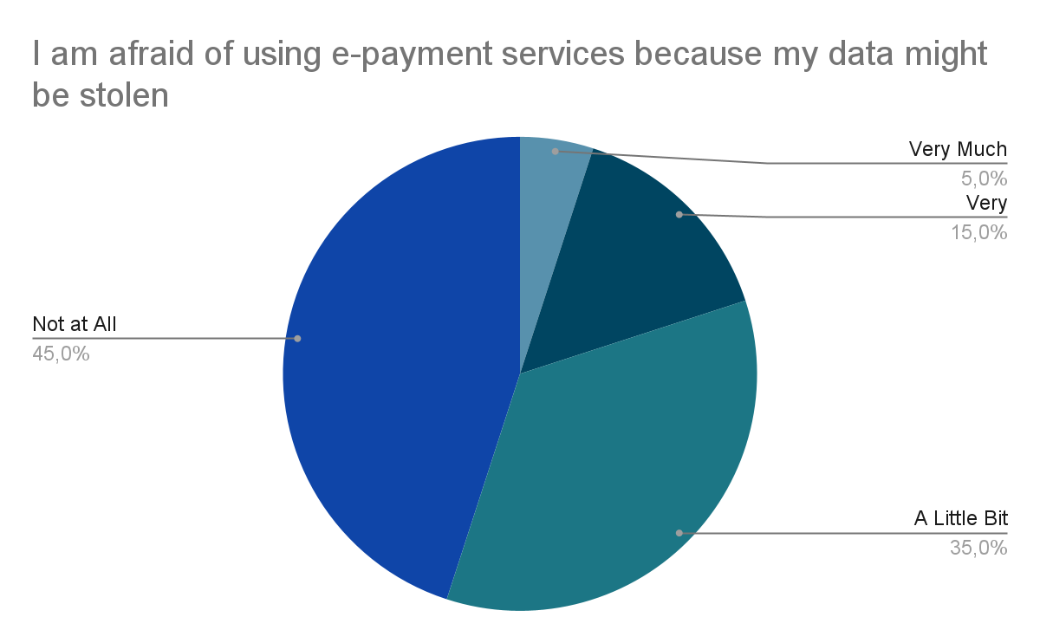
Participants are to a small extent afraid of having their data stolen when using e-payment services

Slide 28
Comparison

Slide 29

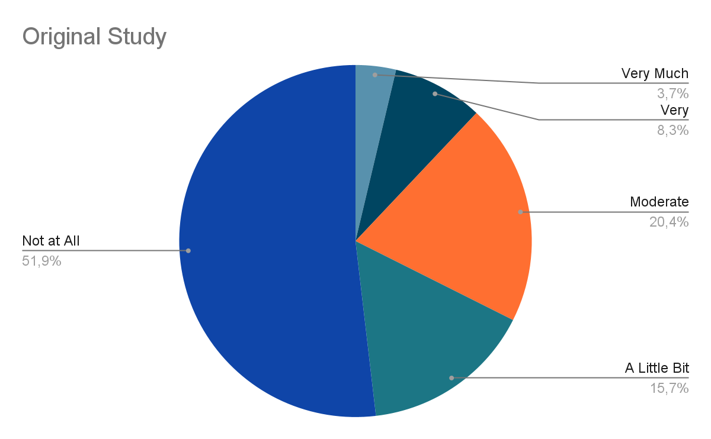
I intend to use household cleaning robots

Slide 30
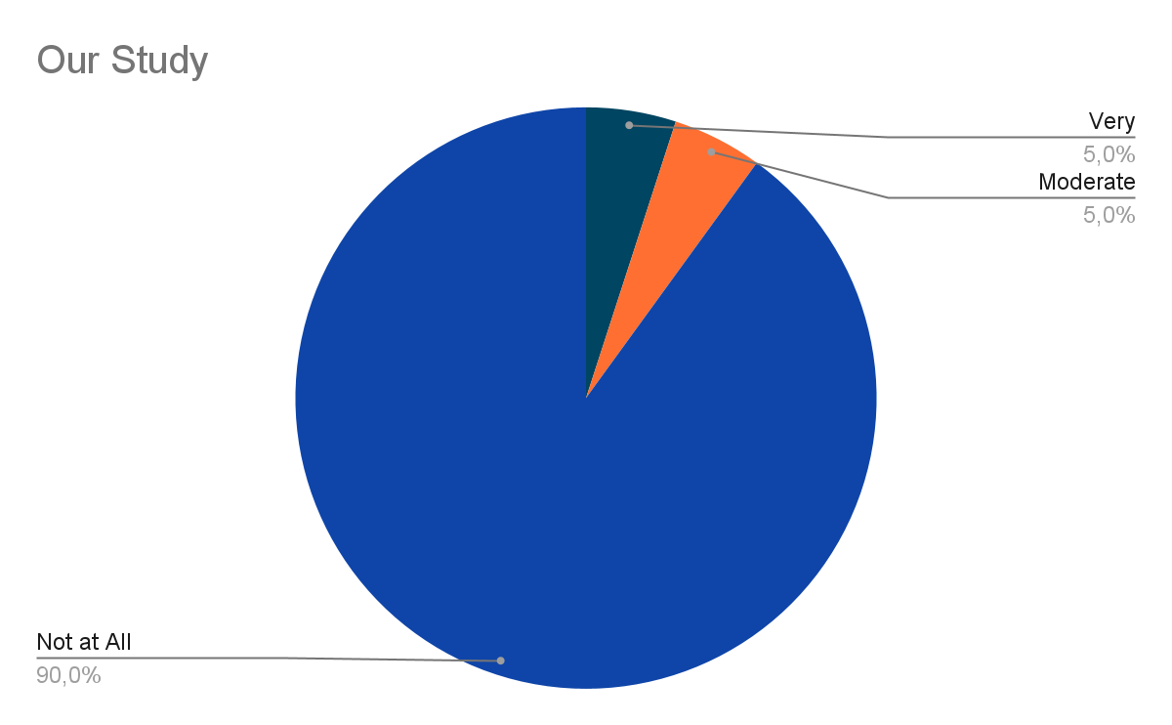
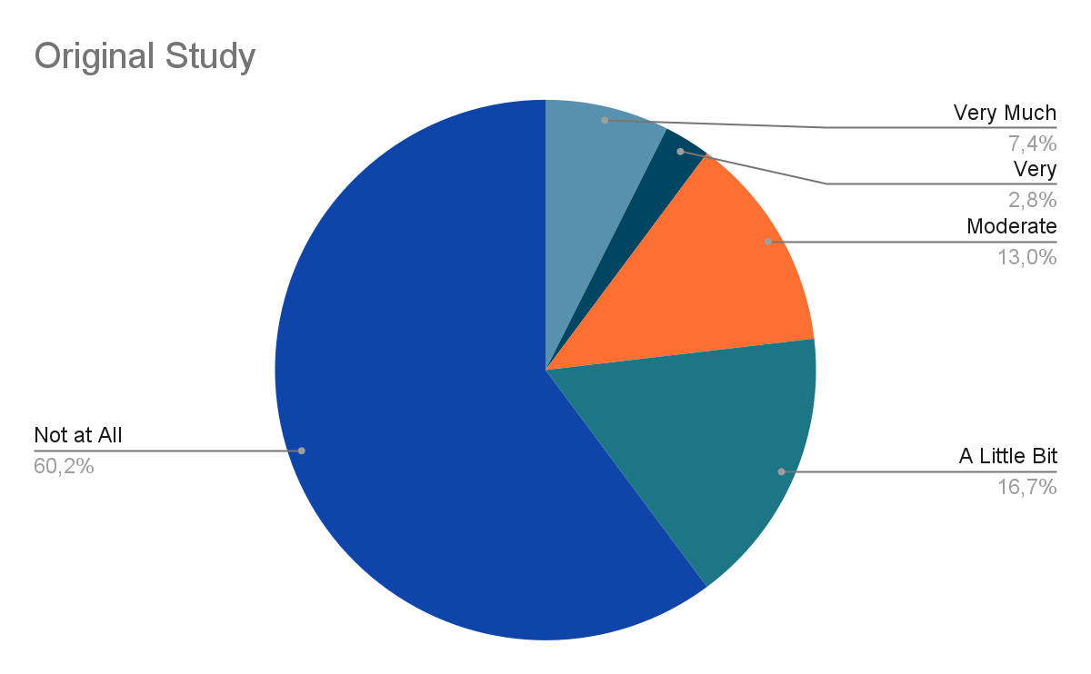
I want to be the first to buy a new product because I will stand out

Slide 31
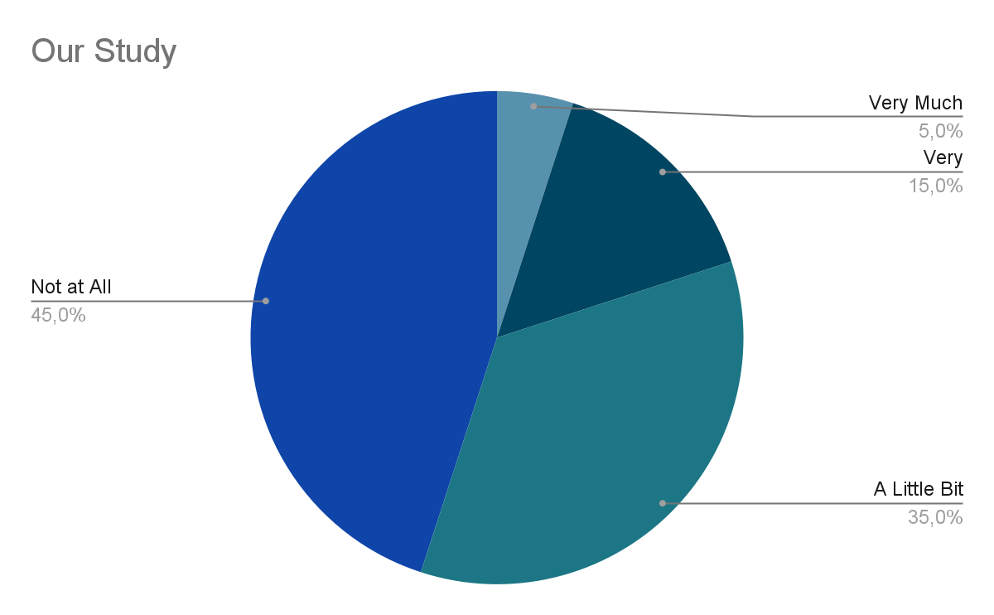
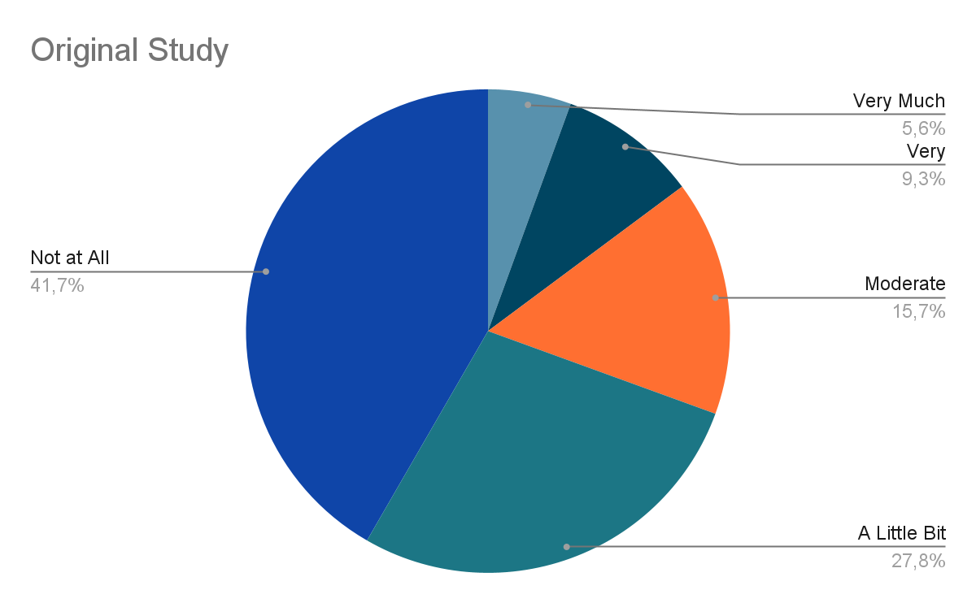
I am afraid of using e-payment services because my data might be stolen

Slide 32
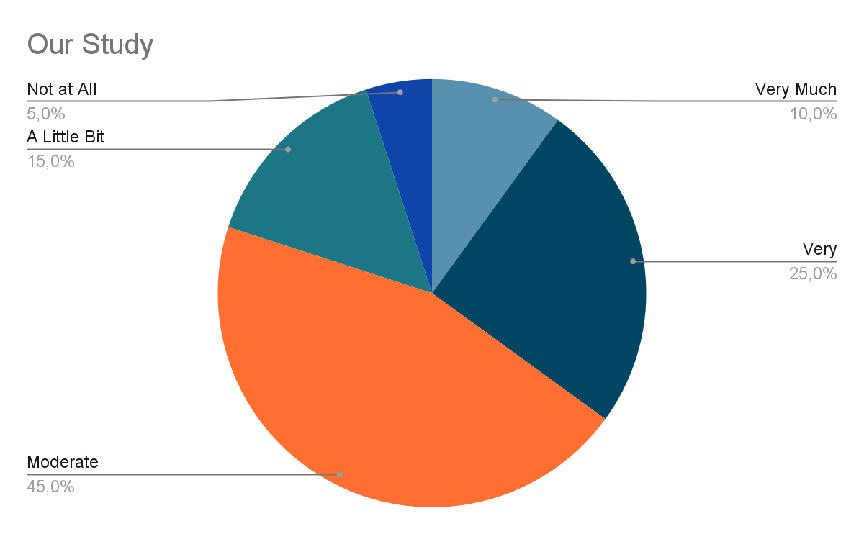
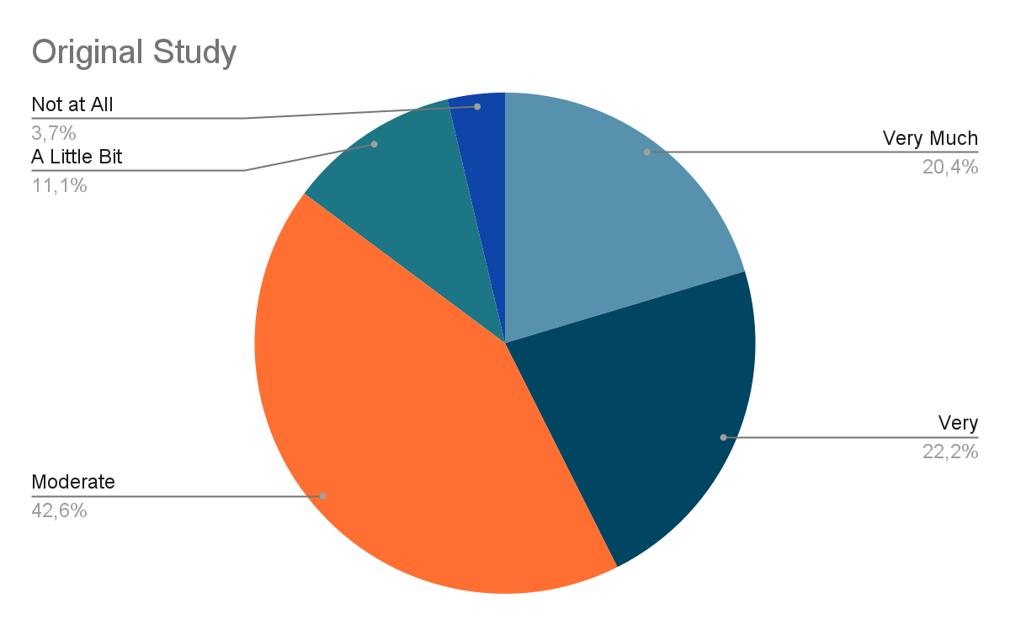
The cost of installing, repairing and maintaining smart home technology is high for me

Slide 33
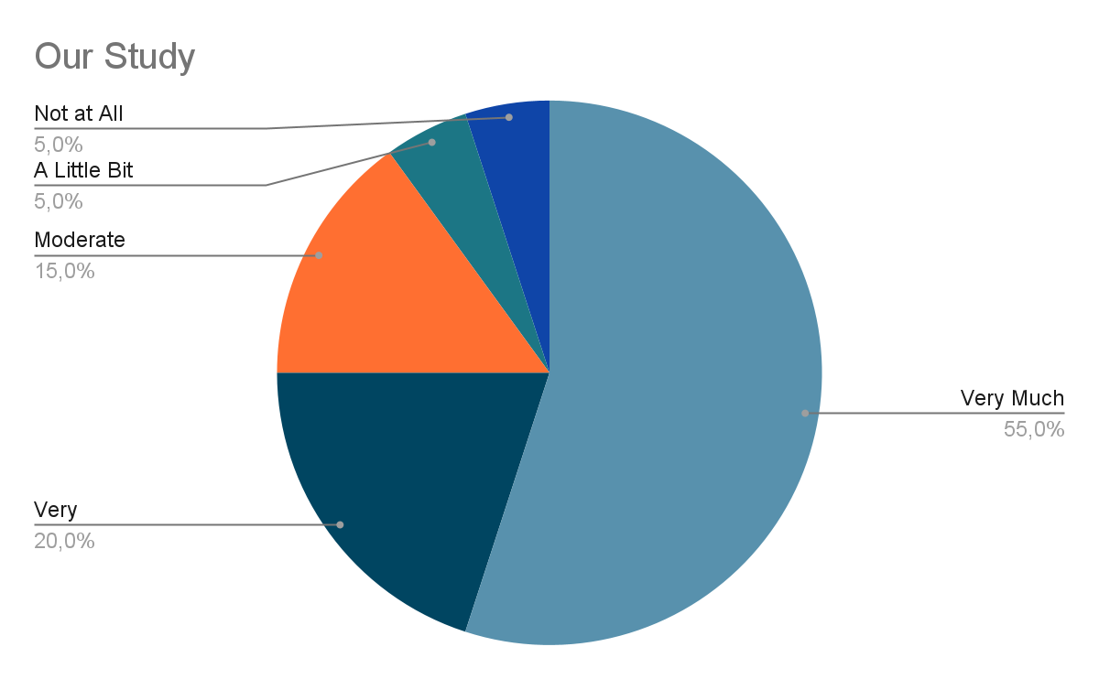
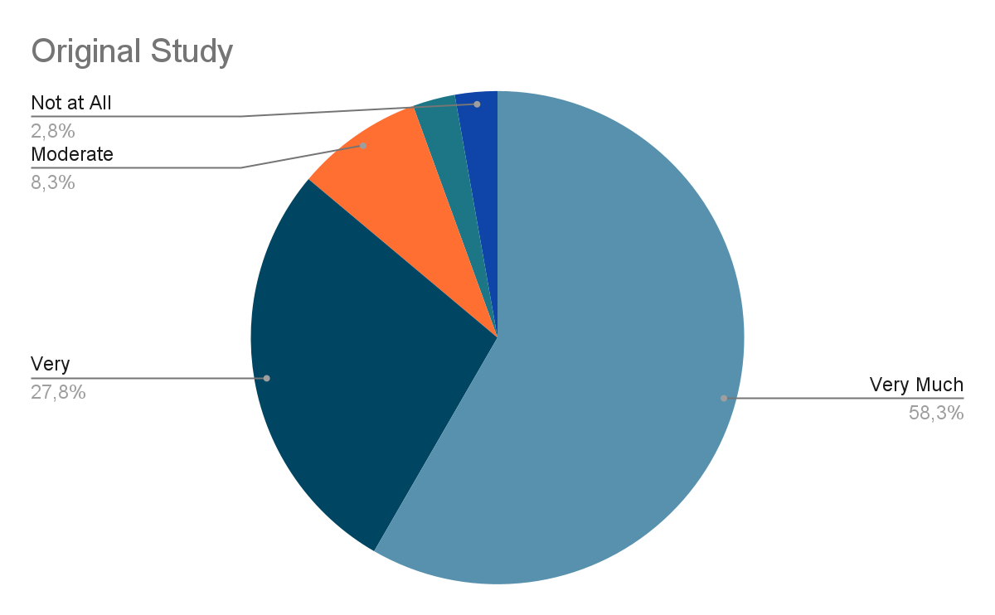
I find the e-payment services useful

Slide 34
Similarities Differences
High perceived cost of installing, repairing and maintaining smart home technology
Perceived usefulness of e-payment services
Fear of data loss when using e-payment methods
Desire to be the first to buy a new product for social recognition
Intention to use household cleaning robots

Slide 35
Our Reflection
Difficulties: Communication (distances of member’s houses)
Likes: Subject of study, making the questionnaire
New Knowledge: Statistics and Technology Terms, bullet point presentation

Slide 36
SOURCES
https://www.mdpi.com/2571-5577/5/1/26
Panayotis Pliatsikas & Anastasios A. Economides (2022). Factors Influencing Intention of Greek Consumers to Use Smart Home Technology. Applied System Innovation, 5(1), 26. https://doi.org/10.3390/asi5010026

Slide 37
Thank you all for your time and attention!

